Slide 1



MEETING IS
STARTING
SOON
FOLLOW US!
@tidaltamu

Slide 2
t i d a l t a m u
TETHERED INFORMATICS & DATA ANALYTICS LAB
Notes:
Follow us on Twitter and Instagram @tidaltamu
Join our discord and slack, links provided in email

Slide 3
Unsupervised Learning
Carson Duffy and Ishaan Grewal
Notes:
We have been using supervised learning over the course of the semester
Now it is time to consider unsupervised learning

Slide 4
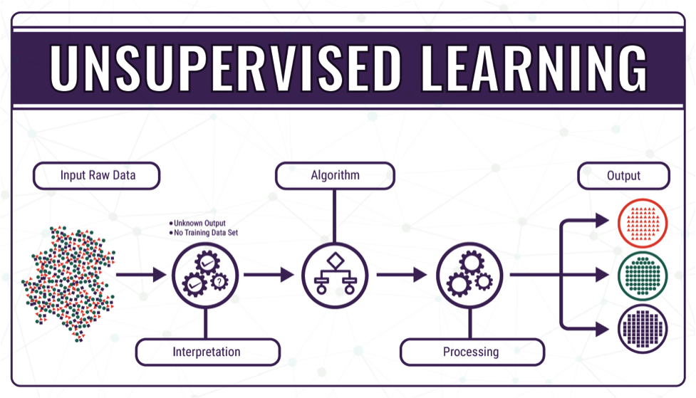
What is Unsupervised Learning?
Notes:
Uses machine learning algorithms to analyze and group unlabeled datasets
Used to discover hidden patterns or data groupings without the need for human assistance

Slide 5
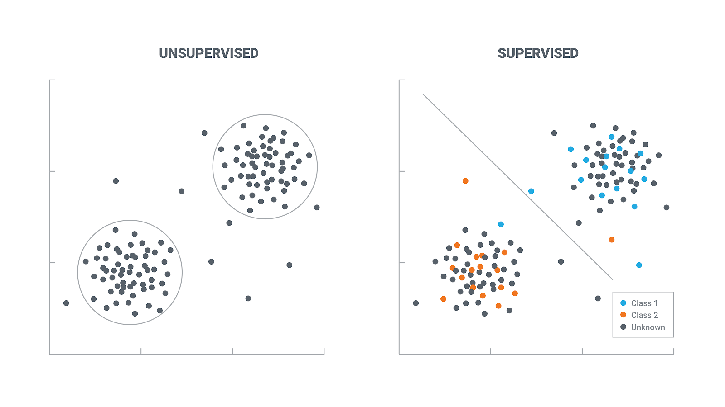
Unsupervised Learning vs. Supervised Learning
Notes:
Supervised learning seeks to classify or predict outputs based on a set of known inputs and outputs
Identify known data points in diagram
The algorithm uses these known data points to identify the unknown data points
Unsupervised learning seeks to classify data points without a specific label
The algorithm finds patterns and relationships between data points to separate them into different categories
This is known as clustering

Slide 6
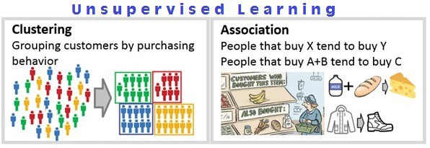
Clustering vs. Association
Notes:
Two types of unsupervised learning that we will cover: clustering and association
Use the example of customers and their spending habits
Clustering seeks to group consumers by their behavior
Association seeks to associate certain outcomes to other outcomes

Slide 7

Clustering
Notes:
Seeks to group unlabeled data into labeled groups
Applications:
Image segmentation
Document clustering
Recommendation Engines

Slide 8
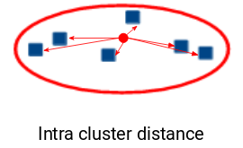
K-Means Clustering
Notes:
Will declare a number of centroids based on the predetermined amount of clusters
The sum of the distances from each data point to its centroid is calculated (“Intra cluster distance”)
The goal of K-Means clustering is to minimize the Intra Cluster Distance across all clusters

Slide 9
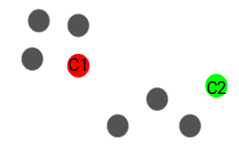
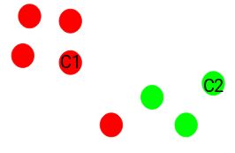
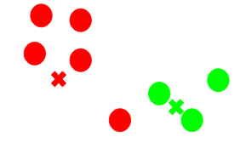
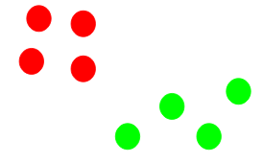
K-Means Clustering
Notes:
Let’s choose two clusters
We’ll assign two random points as the centroids
Then, all of the closest points are assigned to that cluster
The new centroids of the clusters is calculated
Repeat

Slide 10
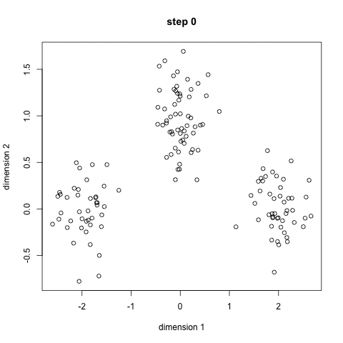
K-Means Clustering
Notes:
The algorithm ends when
The locations of the centroids doesn’t change
The amount of points in a cluster doesn’t change
The maximum amount of iterations is reached
https://www.analyticsvidhya.com/blog/2019/08/comprehensive-guide-k-means-clustering/

Slide 11
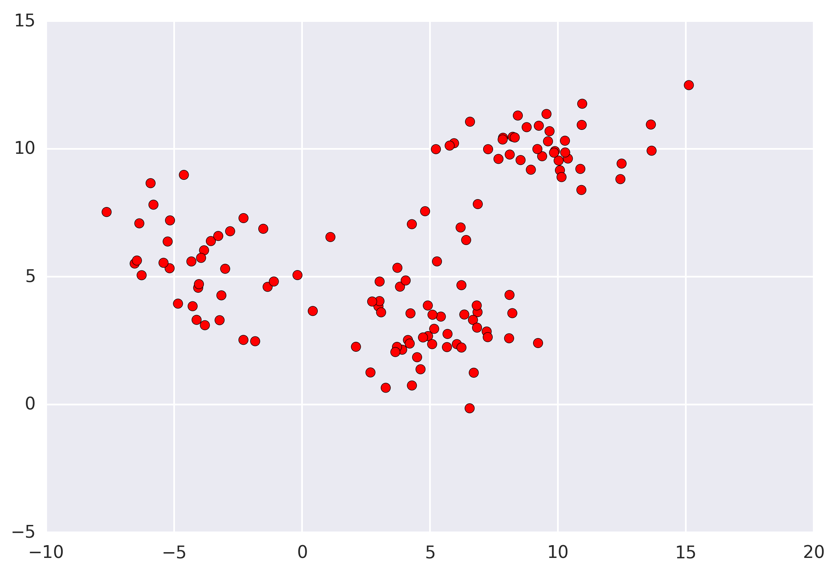
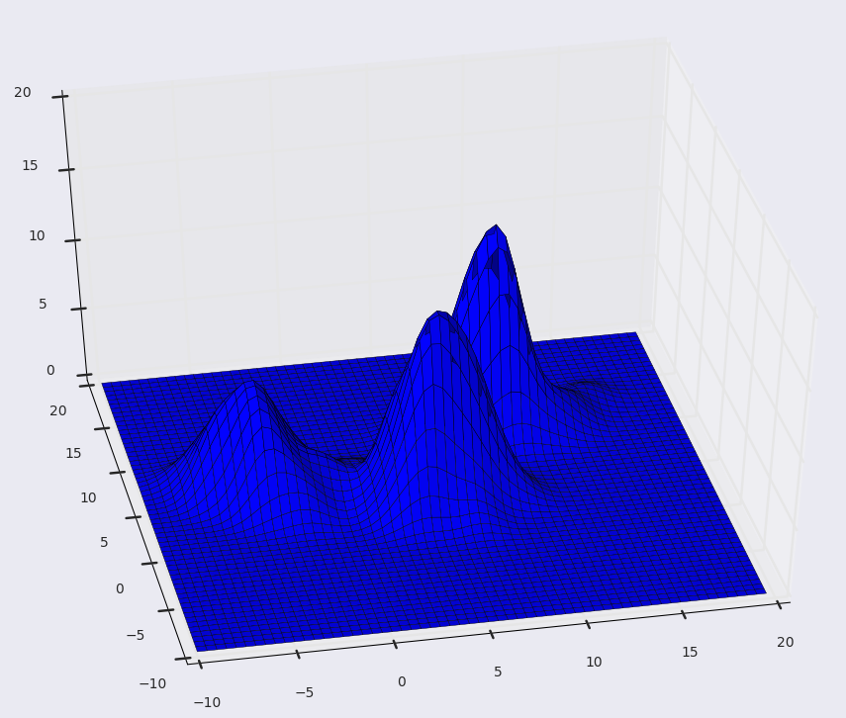
Mean-Shift Clustering
Notes:
Uses Kernel Density Estimation (KDE) to map the frequency of the data points to a gaussian curve (with respect to each axis)

Slide 12
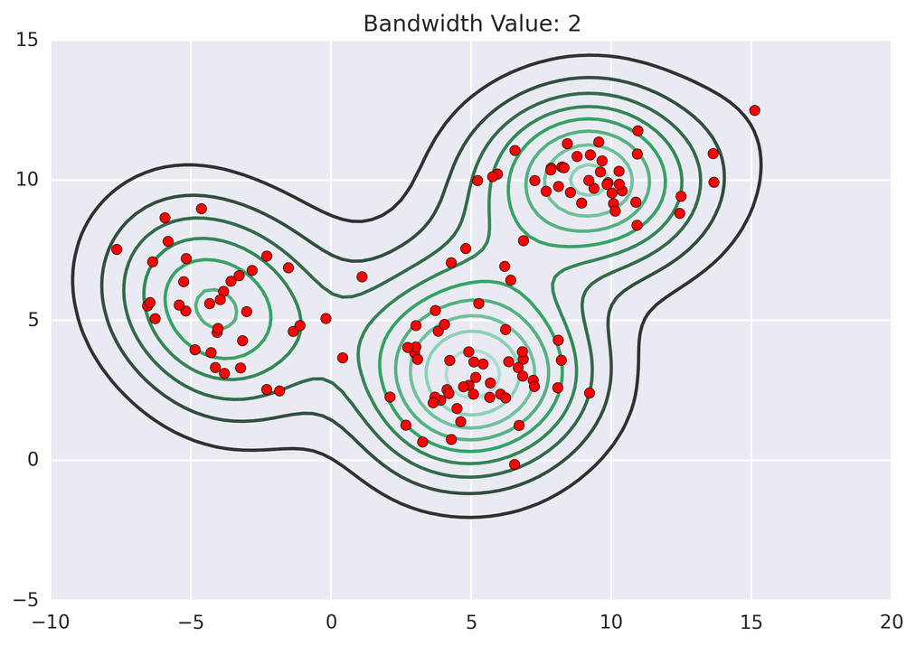
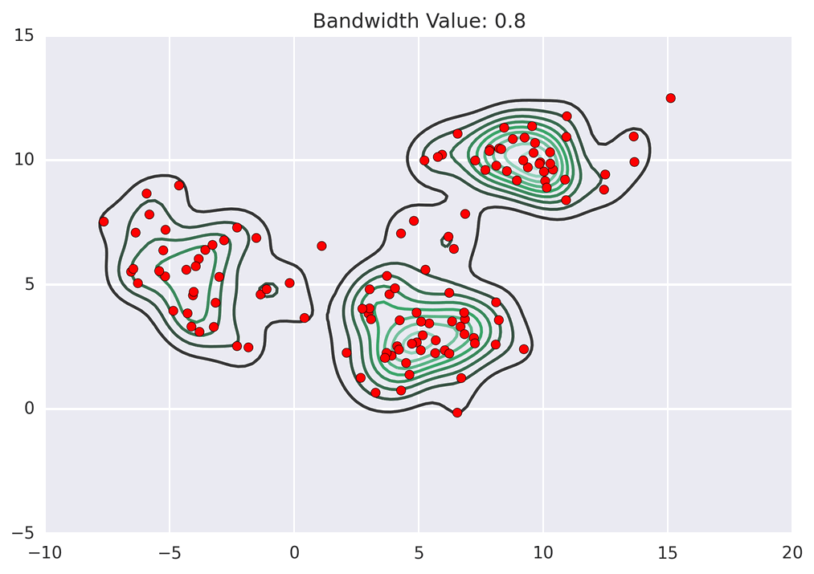
Mean-Shift Clustering
Notes:
Each data point “takes a step” towards the closest peak
The data points that step towards the same peak are placed in the same cluster
Kernel density determines the “smoothness” of the density plot
A smaller bandwidth value results in a more irregular distribution, results in more clusters
This is a hyperparameter; it can be tuned to result in a different amount of clusters
https://spin.atomicobject.com/2015/05/26/mean-shift-clustering/

Slide 13
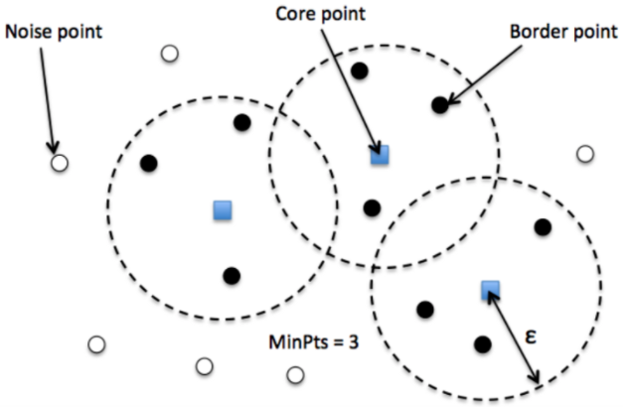
DBSCAN
Notes:
Density-Based Spatial Clustering of Applications with Noise
Based on the idea that clusters are defined as a region of continuous high-point density
Two parameters:
Minimum points that must be clustered together in order for a region to be considered “dense”
Distance used to locate points in a potential cluster (radius of the circle) (epsilon)
Points that lie within the established distance from a core point are “reachable”, called border points
The border points are then considered as core points, cluster begins to form
Noise points are points that are not associated with any given cluster

Slide 14
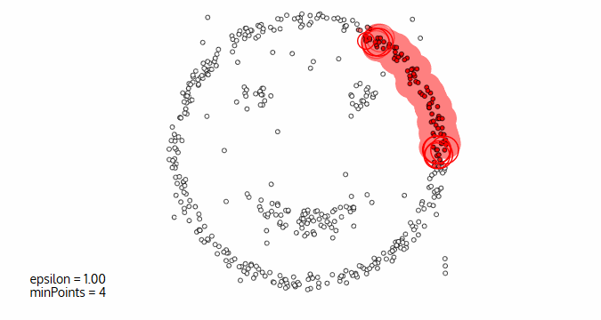
DBSCAN
Notes:
The algorithm first selects a random point, finds the cluster, then selects another random point
This is repeated until every point has been identified as part of a cluster or noise

Slide 15
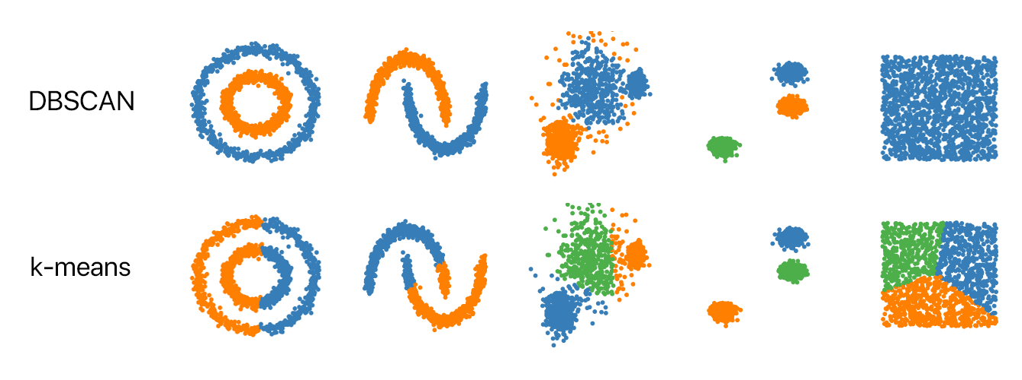
DBSCAN vs. K-Means
Notes:
DBSCAN works well for irregularly-shaped clusters
Walk through examples
Works well for separated clusters as well
The amount of clusters determined by the algorithm itself
https://www.kdnuggets.com/2020/04/dbscan-clustering-algorithm-machine-learning.html

Slide 16
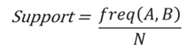
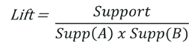
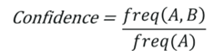
Association
Find rules to describe the data
For eg: People that bought x were likely to buy y.
Notes:
Support: It tells us about the combination of items bought together frequently. It gives the part of transactions that contain both A and B.
Confidence: It tells us how frequently the items A and B are bought together, for the no. of times A is bought.
Lift: It indicates the strength of a rule over the randomness of A and B being bought together. It basically measures the strength of any association rule(we will talk about association rules below).

Slide 17
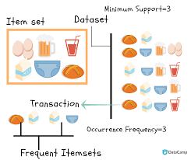
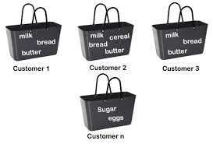
Market Basket Analysis

Slide 18
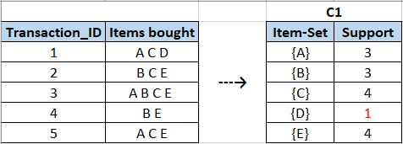
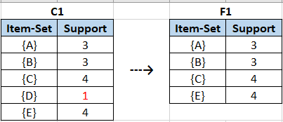
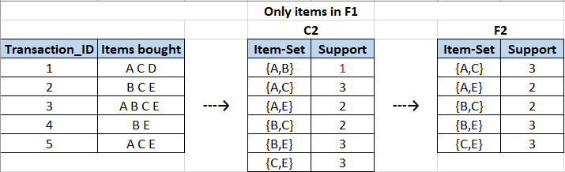
Apriori Algorithm
Notes:
uses frequently bought item-sets to generate association rules. It is built on the idea that the subset of a frequently bought items-set is also a frequently bought item-set. Frequently bought item-sets are decided if their support value is above a minimum threshold support value.

